Slide 1







Zero-Shot Temporal Action Detection
Via Vision-Language Prompting
Sauradip Nag^{1,2} Xiatian Zhu^{2,3} Yi-Zhe Song^{1,2} Tao Xiang^{1,2}
¹CVSSP, University of Surrey, UK
²iFlyTek-Surrey Joint Research Centre for Artificial Intelligence
³Surrey Institute for People-Centred Artificial Intelligence, University of Surrey, UK

Slide 2

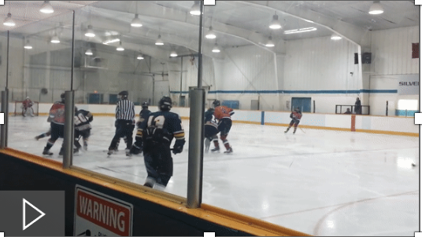
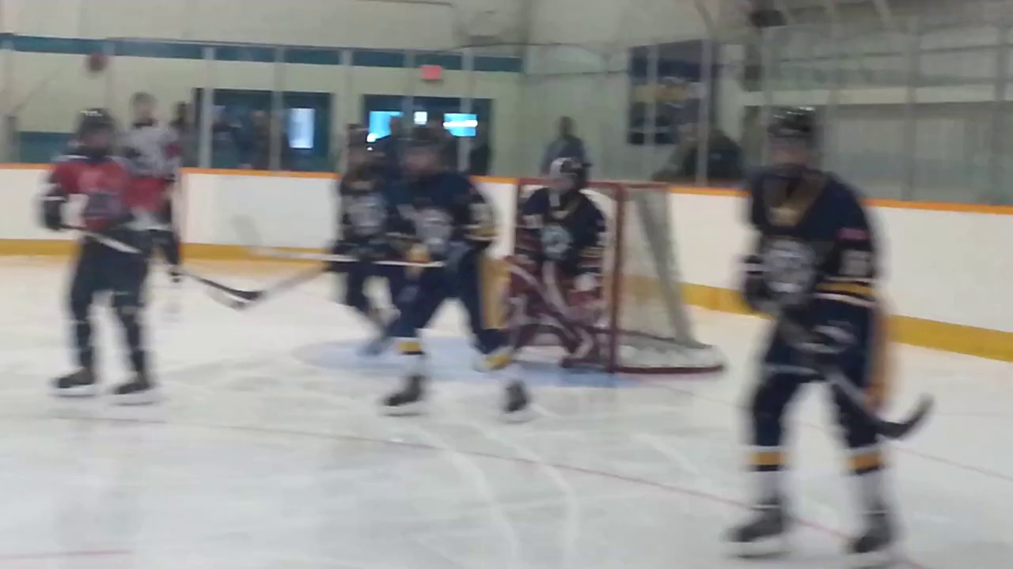
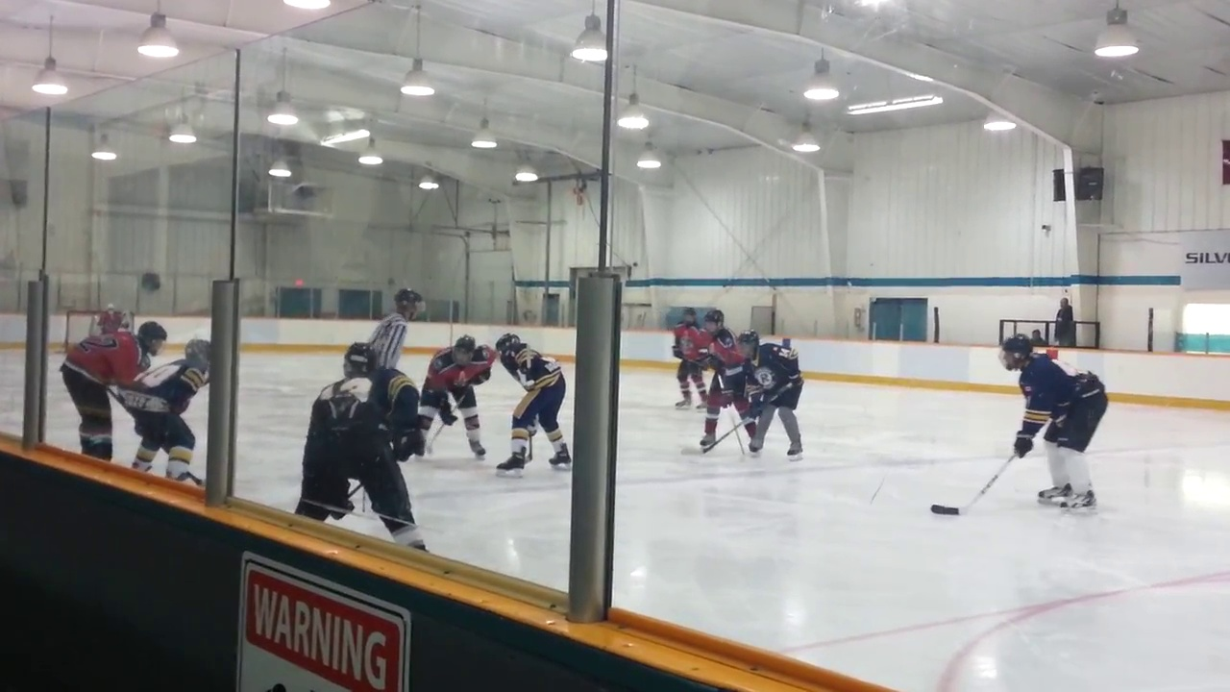
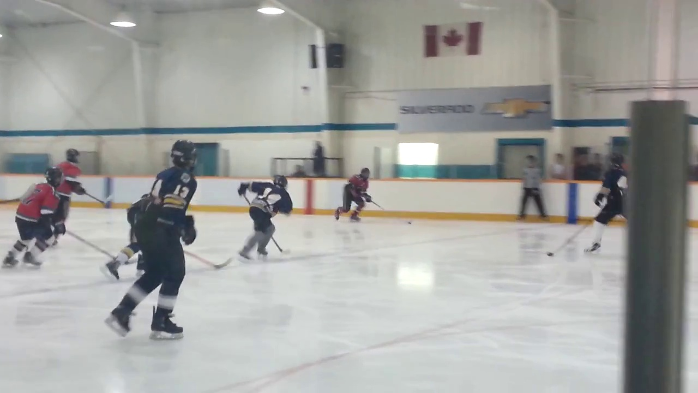
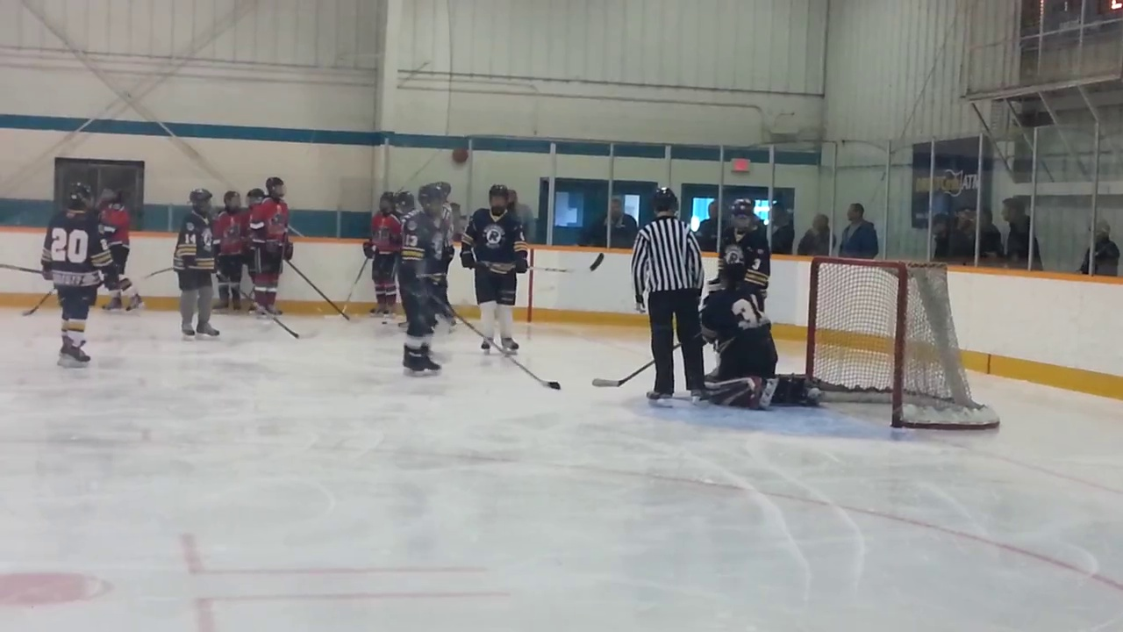
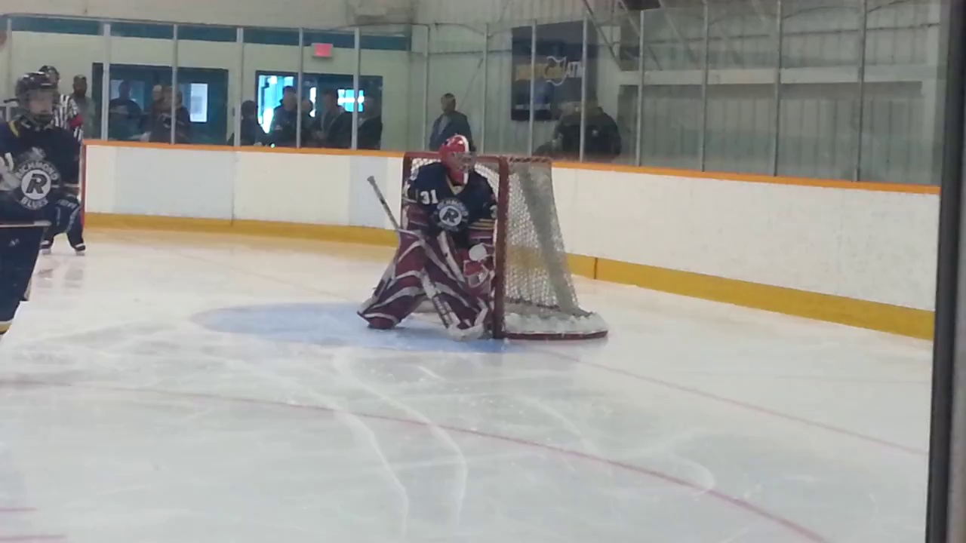
What is Temporal Action Detection ?
What is the Activity ?
(“Playing Ice Hockey”)
SubTask 1 : Action Classification
When is the Activity Occuring ?
(13 s – 28 s )
SubTask 2 : Temporal Regression
Untrimmed Video
Task Definition
Playing Ice Hockey
0
13
28
36 (in sec)

Slide 3
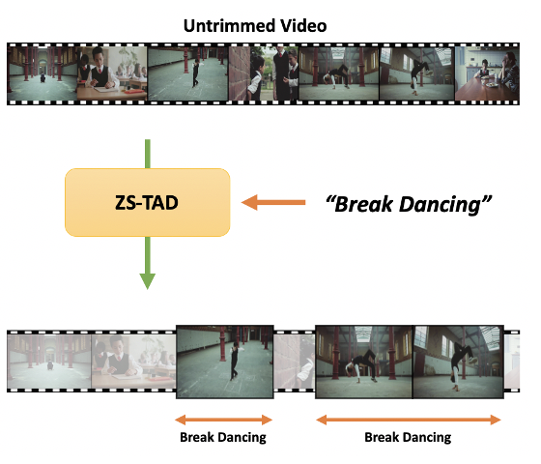
Zero-Shot Temporal Action Detection
Unseen Video, No Annotation
Semantic Context e.g, Text
Localize Unseen Action in Unseen Video

Slide 4
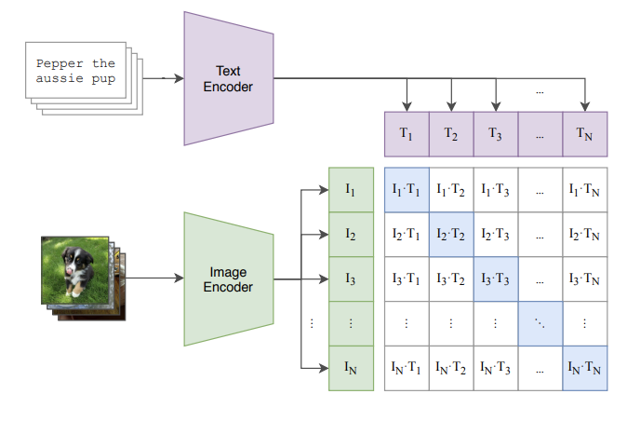
Can Vision-Language based Models Help ?
Align the textual space
and
Visual space
Popular Vision-Language model CLIP¹ was originally designed for Image Classification based tasks
¹Radford et al. , “Learning Transferable Visual Models From Natural Language Supervision".

Slide 5
Can Vision-Language based Models Help ?
Can this be extended
to dense down-stream task ?
Popular Vision-Language model CLIP¹ was originally designed for Image Classification based tasks
¹Radford et al. , “Learning Transferable Visual Models From Natural Language Supervision".

Slide 6
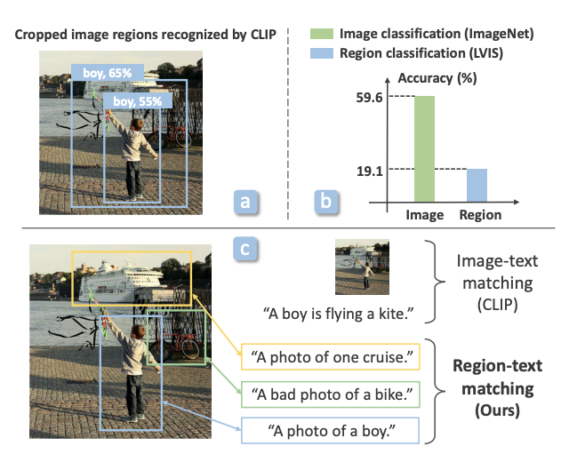
Can Vision-Language based Models Help ?
Image has both foreground and background objects
Text has only foreground
Q: Can they be aligned ?
Solution : Need off-the-shelf object detectors to
crop foreground and then align
RegionCLIP²
²Zhong et al. , “RegionCLIP: Region-based Language-Image Pretraining”, CVPR22.

Slide 7
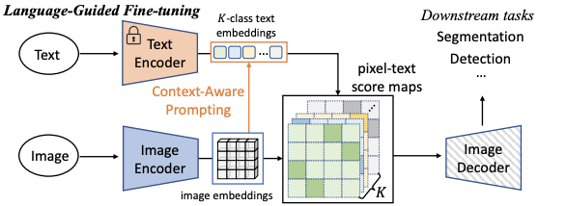
Can Vision-Language based Models Help ?
Image has both foreground and background objects
Text has only foreground
DenseCLIP don’t Pool the Features before Alignment
to preserve Dense Features
Loses Zero-Shot Transfer Property
Only SOTA in Fully-Supervised
DenseCLIP³
1st Vision-Language work for Dense Detection tasks
³Rao et al. , “DenseCLIP: Language-Guided Dense Prediction with Context-Aware Prompting”, CVPR22.

Slide 8
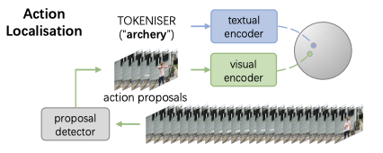
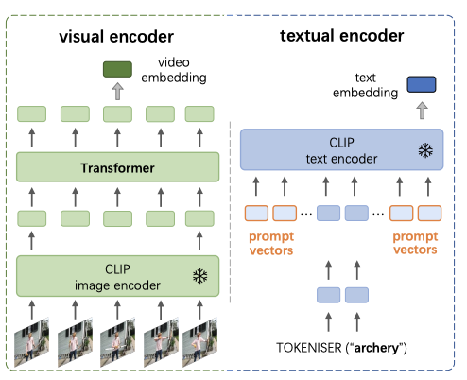
Prior Work using Vision-Language for Action Detection
Stage 1 : Extract the action foreground using
off-the-shelf Action Detectors (e.g BMN)
Stage 2 : Align the CLIP text with Foreground Action
Disadvantages :
Still need a off-the-shelf non-learnable action detector.
2-Stage based design, error propagates from Stage 1.
Using frozen CLIP text features which has not been
trained on videos.
EffPrompt³
³Ju et al. , “Prompting Visual-Language Models for Efficient Video Understanding”, ECCV22.

Slide 9
Can Vision-Language based Models Help ?
Q1 ) Can we eliminate the usage of non-learnable Off-the-Shelf Action Detector
Q2) Can we reduce the localization-error propagation suffered by these 2-stage approaches
Q3) Can we maintain the Zero-Shot Task Transfer property for Dense Prediction Tasks

Slide 10
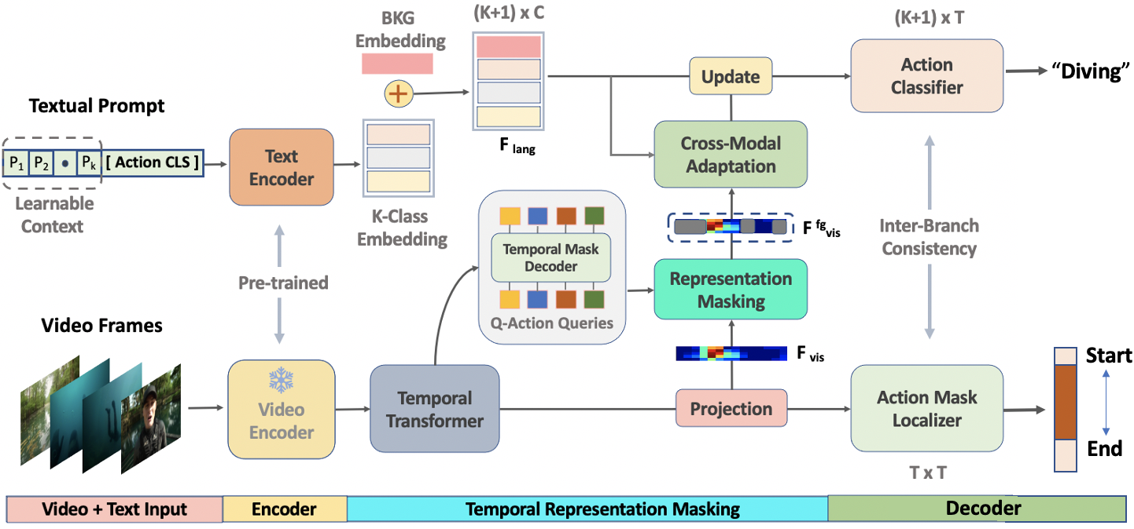
Architecture Design
Zero-Shot Temporal Action Detection via Vision-LanguagE Prompting (STALE)

Slide 11
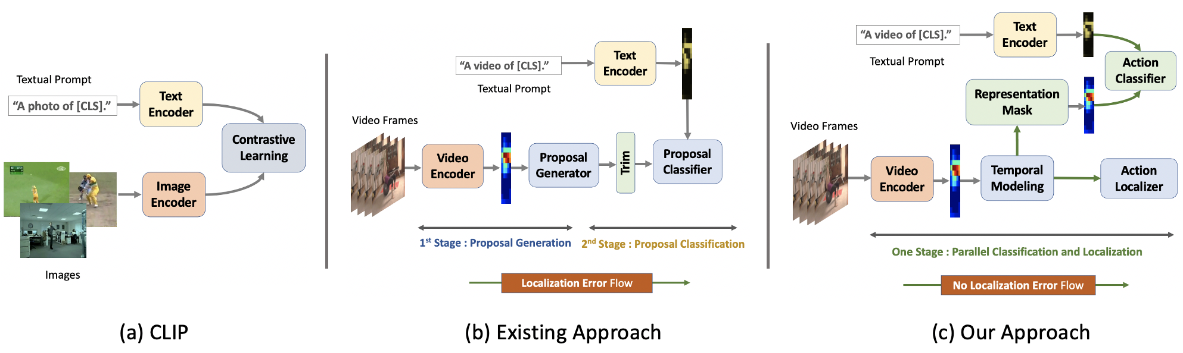
Our Solution using Vision-Language for Action Detection
(a)
EffPrompt³
(b) Our
Single-Stage Design , hence no error flow from proposal generation to classification
No need of off-the-shelf action detectors
Maintains the Zero-Shot transfer property even while detecting unseen actions
³Ju et al. , “Prompting Visual-Language Models for Efficient Video Understanding".

Slide 12
STALE : Feature Embedding
Goal : Given raw video frames, extract CLIP
Pre-Trained Multi-Modal Feature embedding
Raw Video Frames are passed into a Frozen CLIP Image Encoder* to obtain Snippet Features
Each Snippet is passed into a Multi-Head Transformer ( Temporal Module ) to obtain the Global Temporal Context.
For text, we pass the Action-Class into Learnable Prompt to Learnable CLIP Text Encoder obtain Textual Features

Slide 13
STALE : Representation Masking
Goal : Given video features, extract foreground
features to align with textual features
Uses MaskDecoder to mask-out the action foreground generalizable to unseen classes
Foreground Video Features can be aligned with the foreground classes from textual space
Gives some hint of action foreground to Decoders

Slide 14
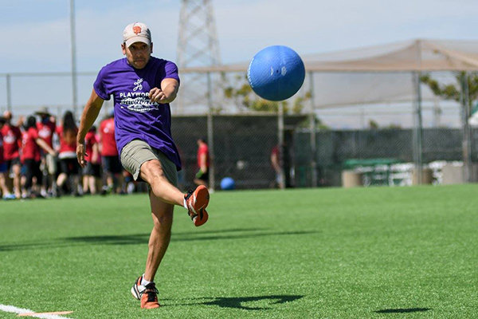
STALE : Cross-Modal Alignment
Goal : Enhance Textual Features with
Visual Context
“A man playing Kickball in a outdoor grass field”
Is better than
“A video of playing Kickball”
Use Self-attention to enhance the
textual features with visual context

Slide 15
STALE : Action Decoder Heads
Goal : Detect the Actions in Video
We use traditional CLIP style classifier without pooling multi-modal features
We use Dynamic 1-D CNN blocks to localize the video-level action masks
We also add a constraint between branches to maintain consistency

Slide 16

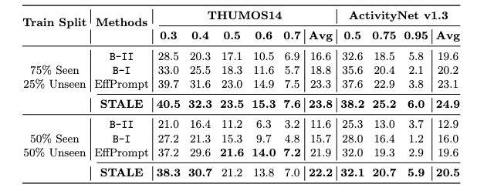

Quantitative Results : Open-Set Setting
Datasets :
9k Training, 5k Testing Video
1.
Short Videos ( ~ 3-4 mins )
70% Long Single FG Instance
200 Training, 213 Testing Video
2.
Long Videos ( ~ 9-14 mins )
85% Short Multi FG Instance
Performance :
Table 1
We reach new SOTA on both the Datasets we reach
SOTA by ~ 1.8 % on Avg mAP
and ~ 1.1 % on mAP@0.5
Settings : 50% Train Split , 75 % Train Split

Slide 17
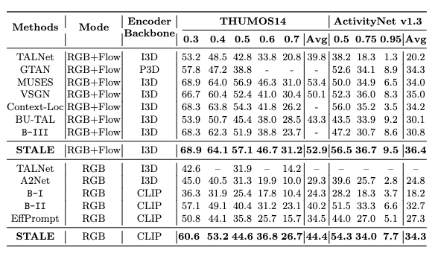
Quantitative Results : Closed-Set Setting
Datasets :
9k Training, 5k Testing Video
1.
Short Videos ( ~ 3-4 mins )
70% Long Single FG Instance
200 Training, 213 Testing Video
2.
Long Videos ( ~ 9-14 mins )
85% Short Multi FG Instance
Performance :
Table 2
We reach new SOTA on both the Datasets we reach
SOTA by ~ 1.6 % on Avg mAP
and ~ 3.5 % on mAP@0.5

Slide 18
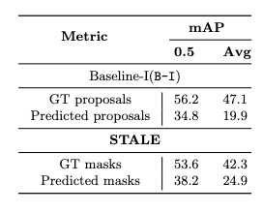
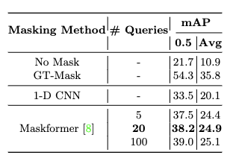
Ablation Studies
Table 3
Table 4
Localization Error Propagation
Impact of Representation Masking

Slide 19
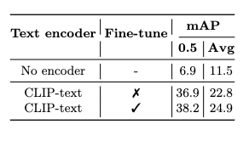
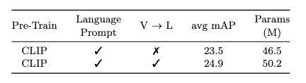
Ablation Studies
Table 5
Table 6
Effect of Text-Encoder training
Effect of Cross-Modal Adaptation

Slide 20

Thank You for Listening
Scan the QR Code for more details

